Slide 1
Exercise 2: Quantifying Tumor Burden for H&E slides
Goals:
Setting the stain and color deconvolution
Detecting the tissue of interest
Detecting individual cells/objects
Annotating objects
Assign classes
Building a classifier
Generate scripts for running through a project

Slide 2
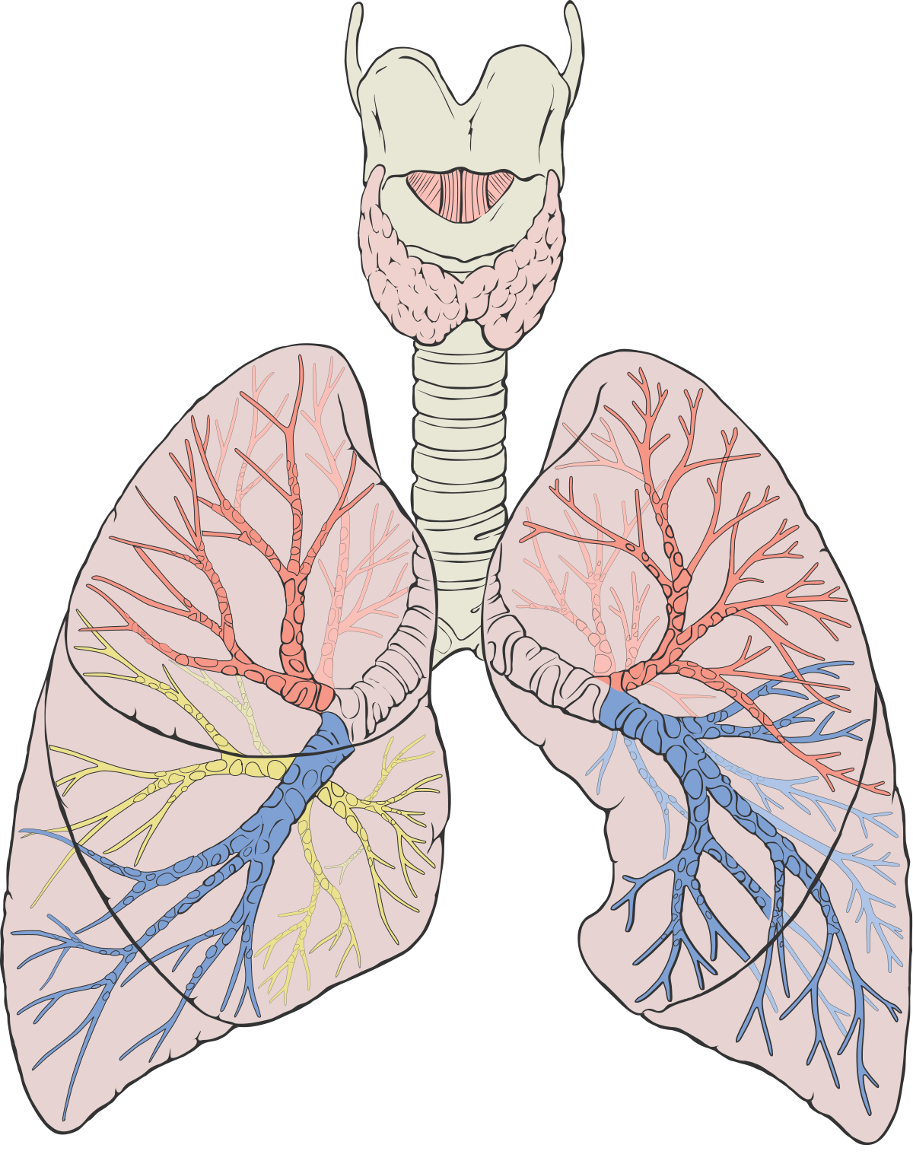
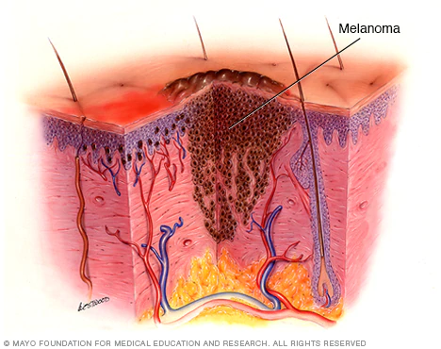
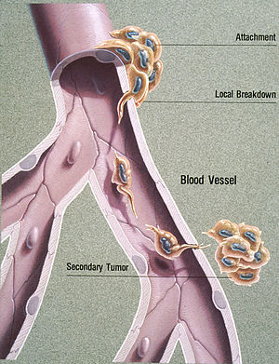
Tumor Metastasis to Lung - Biology vs Experiment

Slide 3
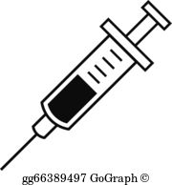
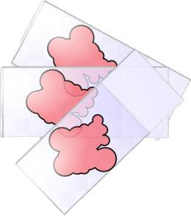
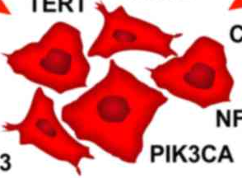
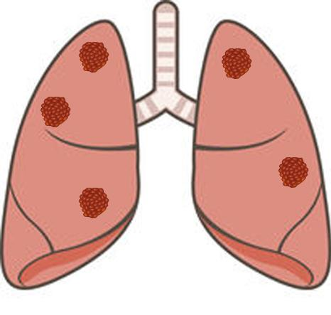

Tumor Metastasis to Lung - Biology vs Experiment
300,000 B16F10
21 days
Fixation:
4% Zinc Formalin
by intratracheal instillation
Procedure was practiced and optimized BEFORE experiment
10 mice per group, repeated 2x
Histology handled FFPE blocks, H&E stains and scanning slides

Slide 4
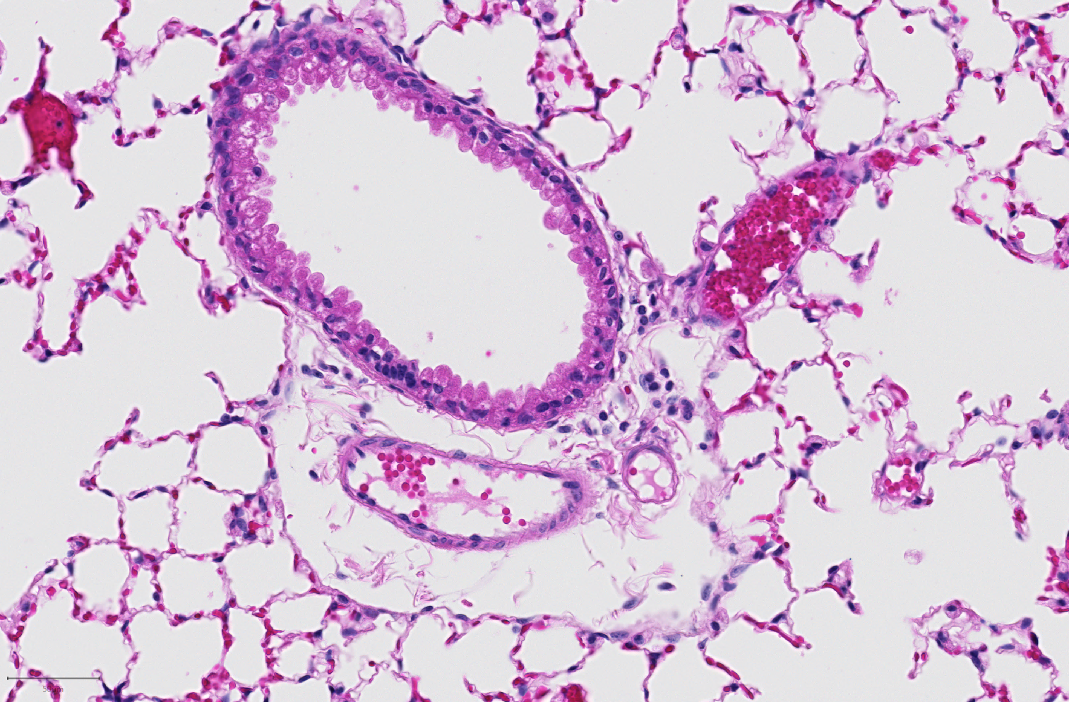
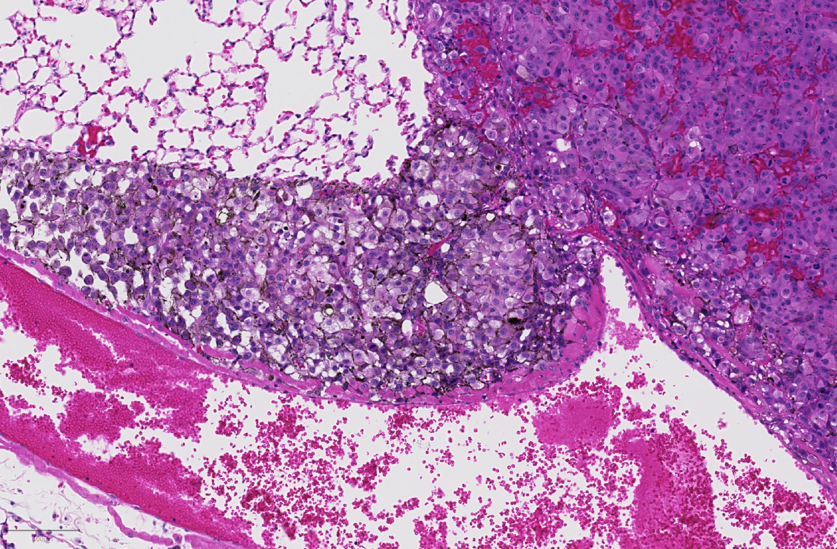
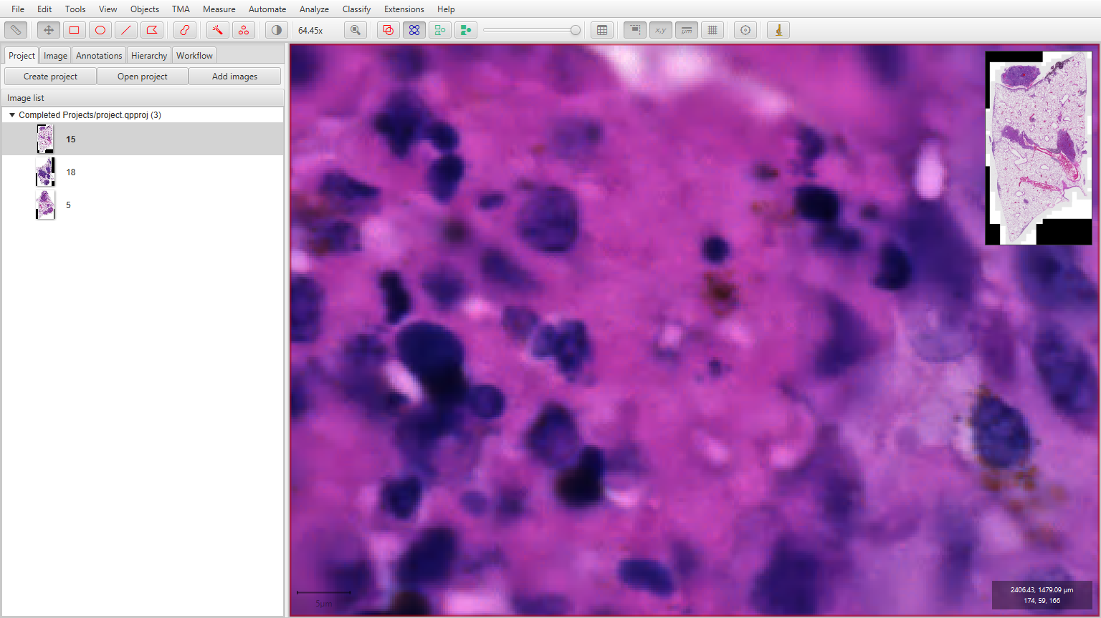
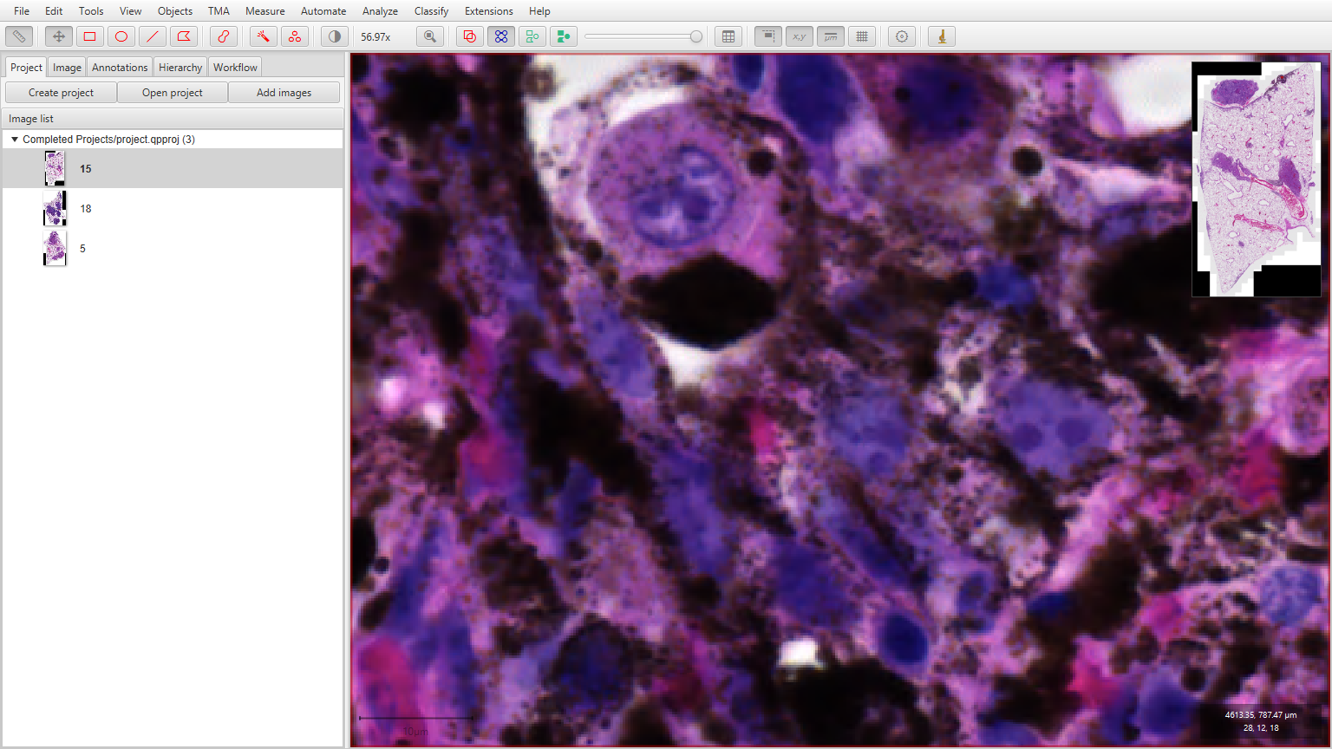
Tumor Metastasis to Lung - what are we looking for?
Normal Lung cells
Necrotic area
Normal Lung cells
Epithelial airway cells
Red blood cells
Melanin
Endothelial cells
Collagen
Endothelial cells
Red blood cells

Slide 5

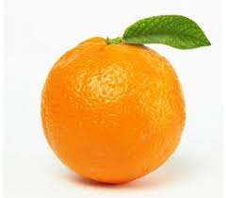
A few tips on how to annotate images for classifying
See how your classifier is doing by selecting Auto-update
Be careful - don’t confuse your model.
Annotate a variety of examples, don’t be lazy.
Annotate across your slide.
Try to balance your classes.
Just enough is usually better than too much.
It is never going to be perfect. If you add too many examples, you will overtrain your model, and it won’t work across your samples.
Use Rebuild training from project.

Slide 6
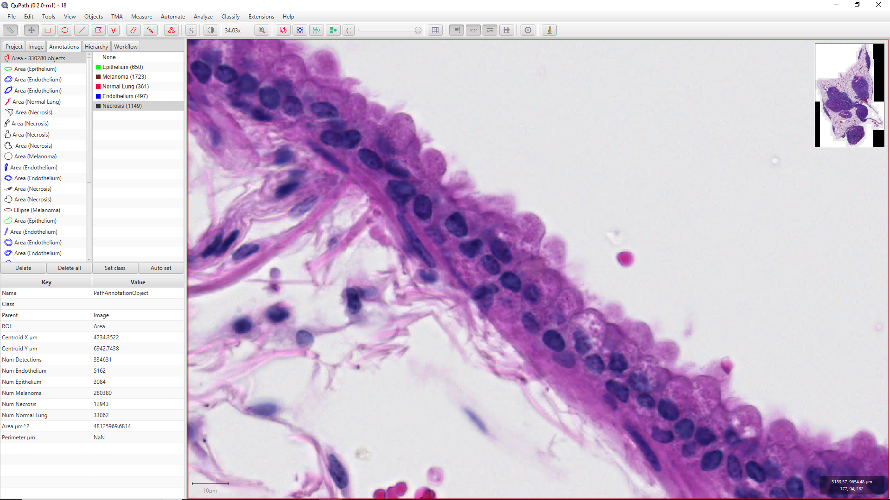
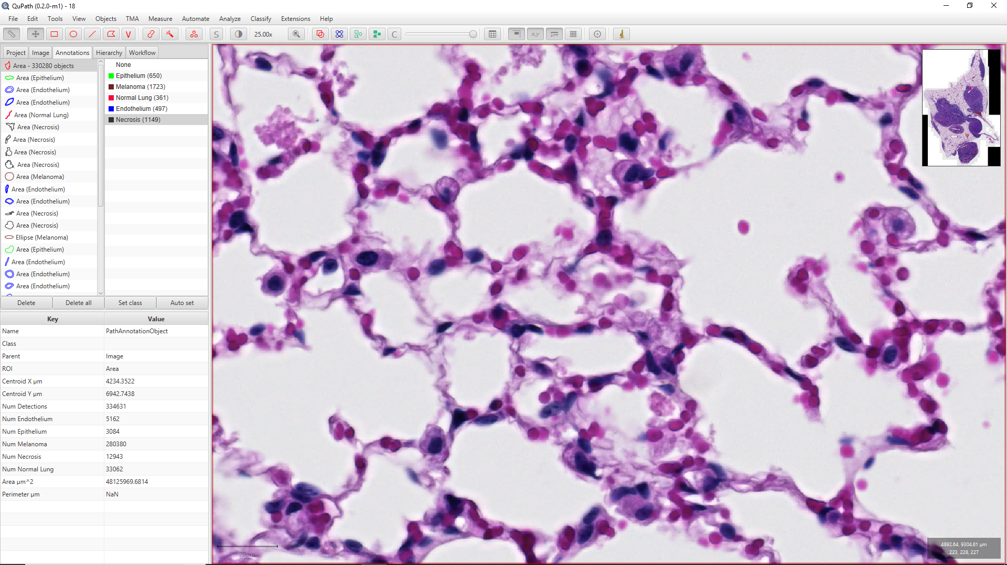
A few tips on how to annotate images for classifying
Epithelium
Normal Lung

Slide 7
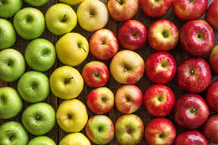
What happens when there is more variability in a type of tissue?

Slide 8
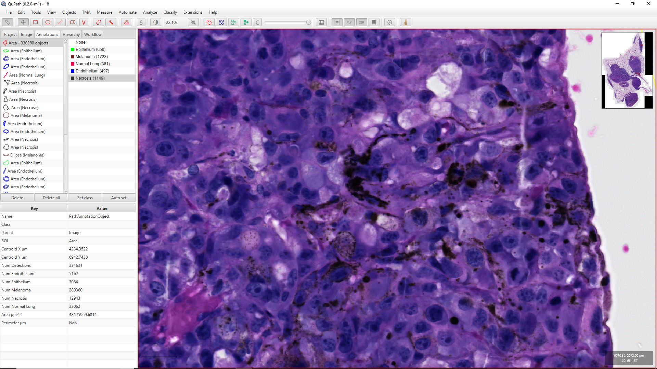
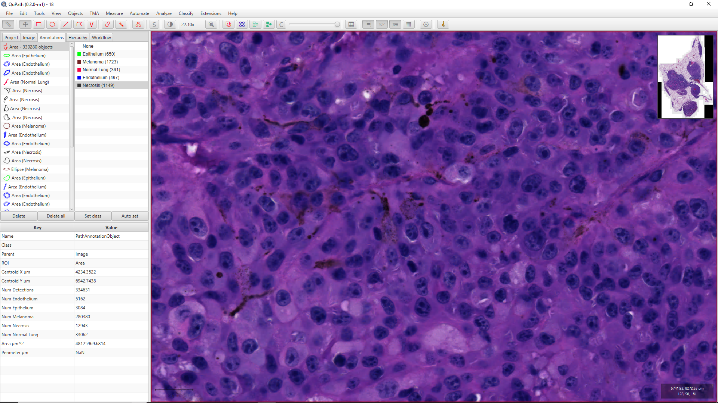
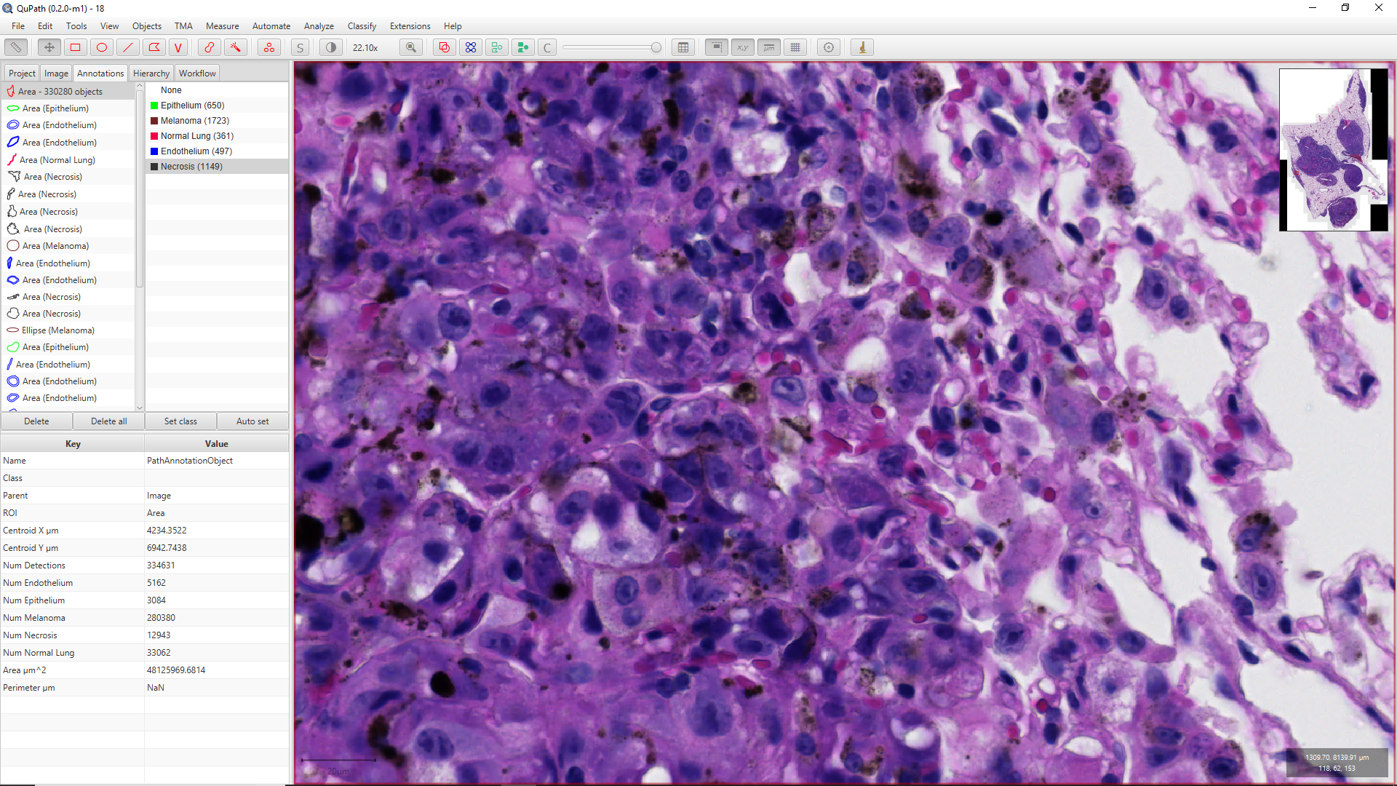
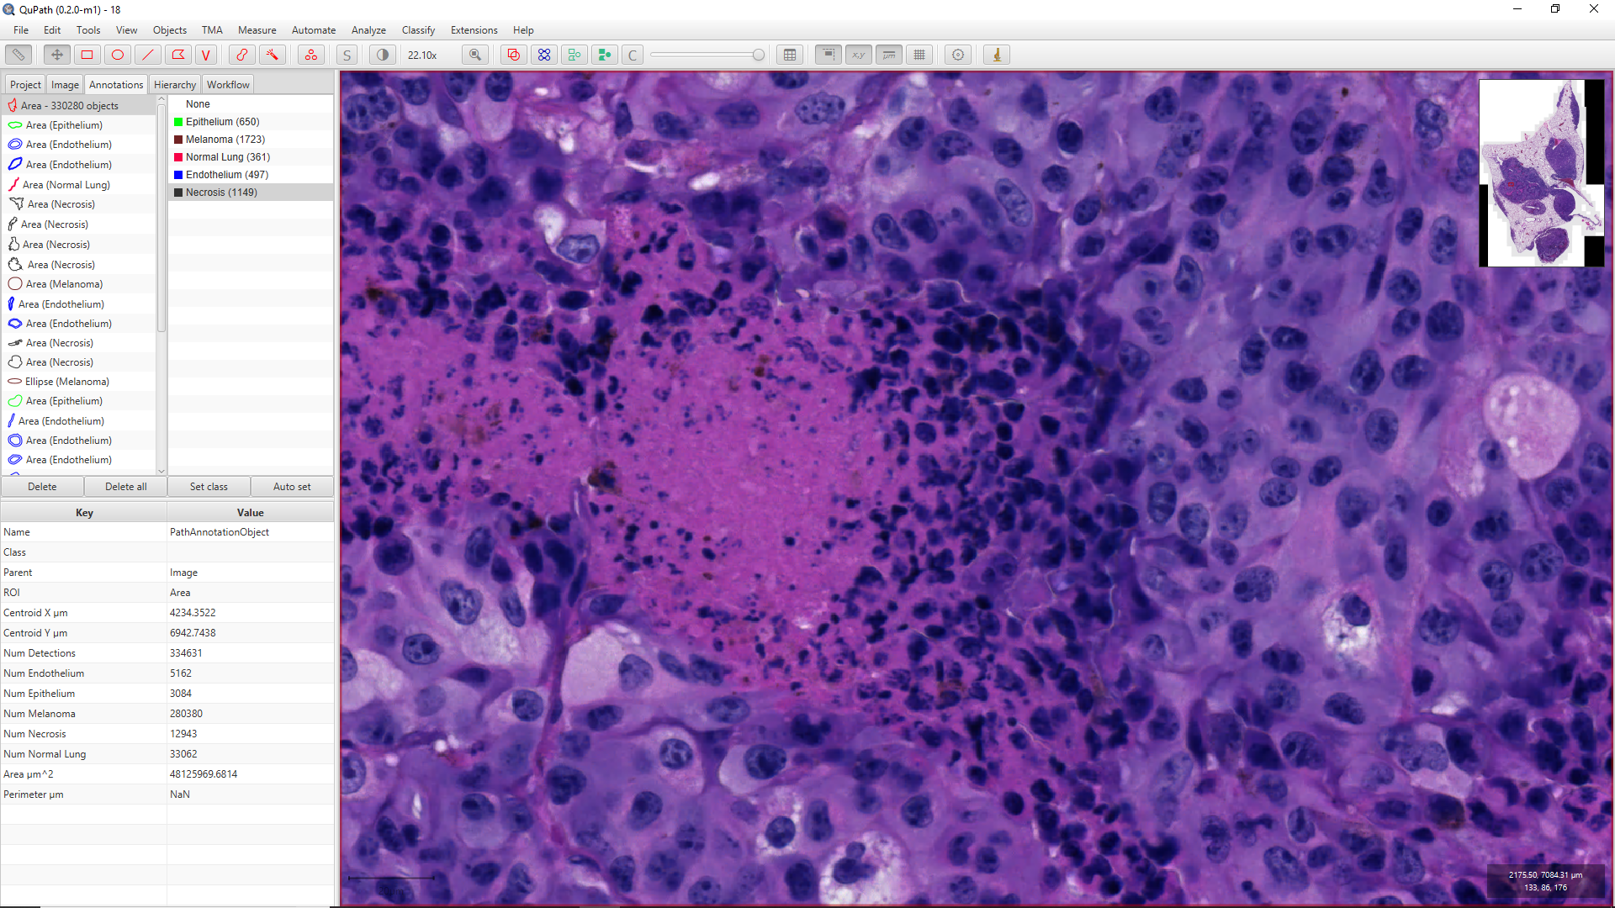
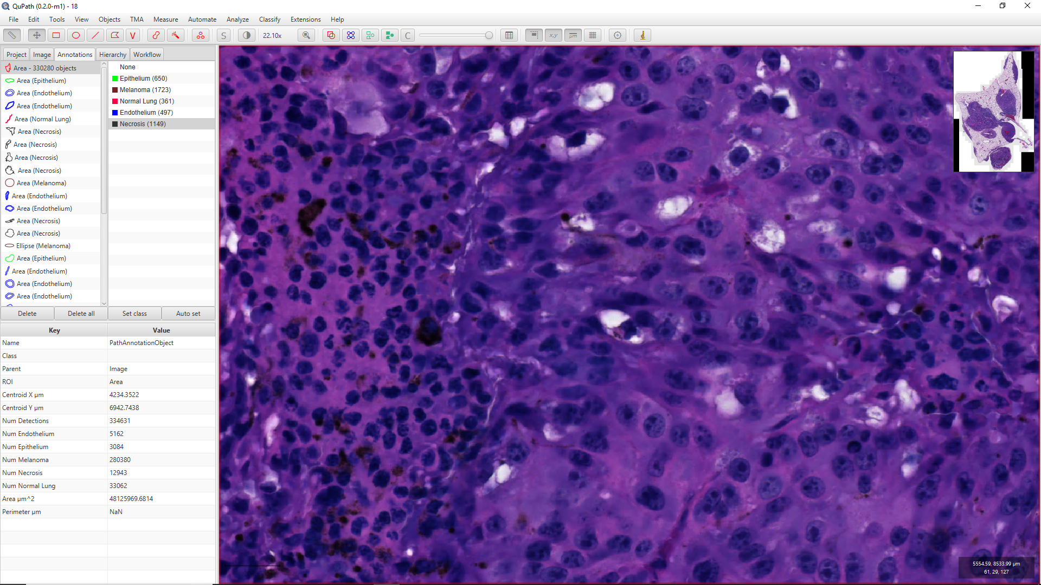
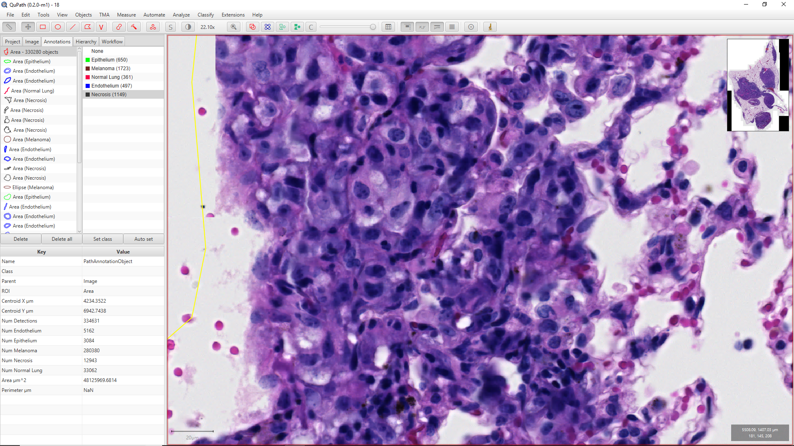
Different stages of a tumor might require multiple annotations...

